Slide 1
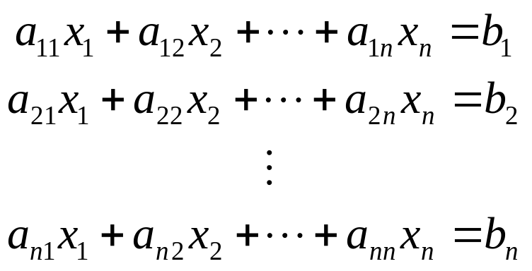
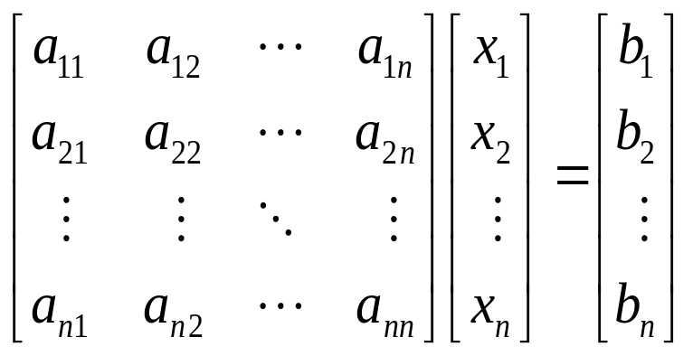
Solution of linear system of equations
Circuit analysis (Mesh and node equations)
Numerical solution of differential equations (Finite Difference Method)
Numerical solution of integral equations (Finite Element Method, Method of Moments)
⇒

Slide 2
Consistency (Solvability)
The linear system of equations Ax=b has a solution, or said to be consistent IFF
Rank{A}=Rank{A|b}
A system is inconsistent when
Rank{A}<Rank{A|b}
Rank{A} is the maximum number of linearly independent columns or rows of A. Rank can be found by using ERO (Elementary Row Oparations) or ECO (Elementary column operations).
ERO⇒# of rows with at least one nonzero entry
ECO⇒# of columns with at least one nonzero entry

Slide 3
Elementary row operations
The following operations applied to the augmented matrix [A|b], yield an equivalent linear system
  Interchanges: The order of two rows can be changed
  Scaling: Multiplying a row by a nonzero constant
  Replacement: The row can be replaced by the sum of that row and a nonzero multiple of any other row.

Slide 4
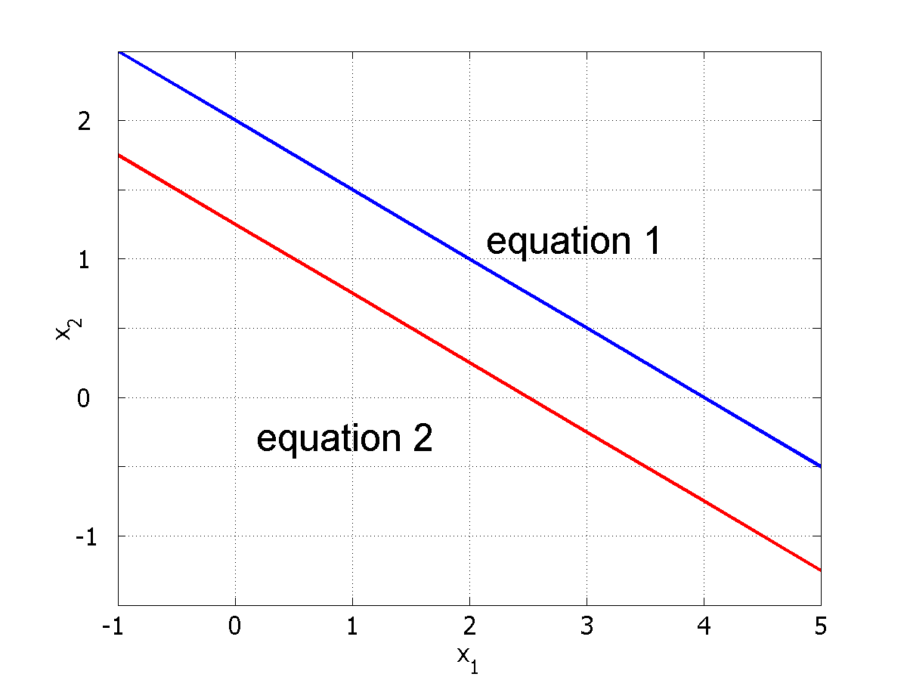
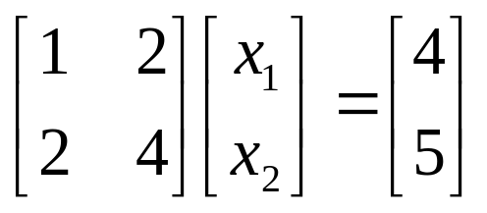
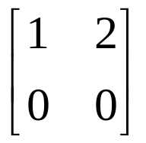
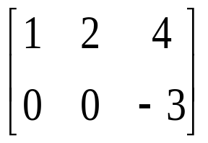
An inconsistent example
ERO:Multiply the first row with
-2 and add to the second row
Rank{A}=1
Then this system of equations is not solvable
Rank{A|b}=2

Slide 5
Uniqueness of solutions
The system has a unique solution IFF
Rank{A}=Rank{A|b}=n
n is the order of the system
Such systems are called full-rank systems

Slide 6
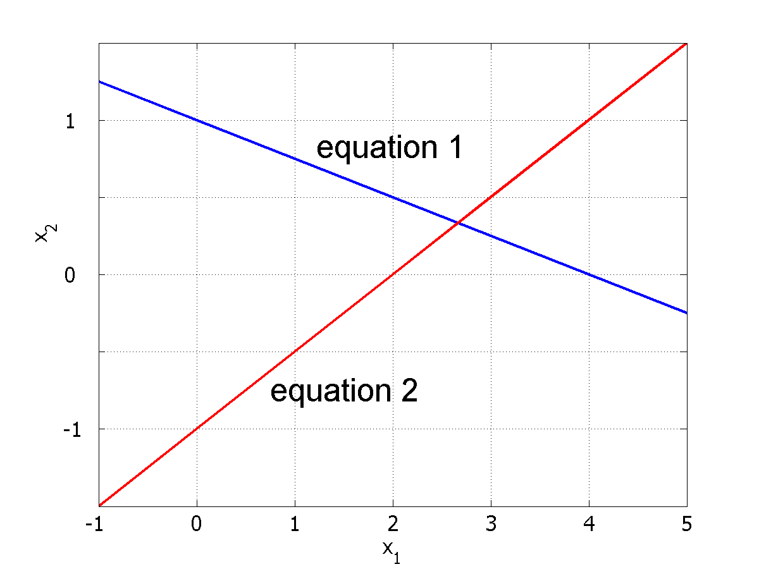
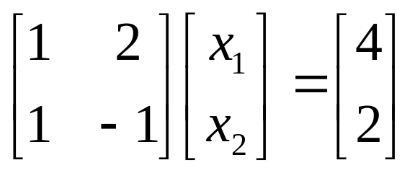
Full-rank systems
If Rank{A}=n
Det{A} ≠ 0 ⇒ A is nonsingular so invertible
Unique solution

Slide 7
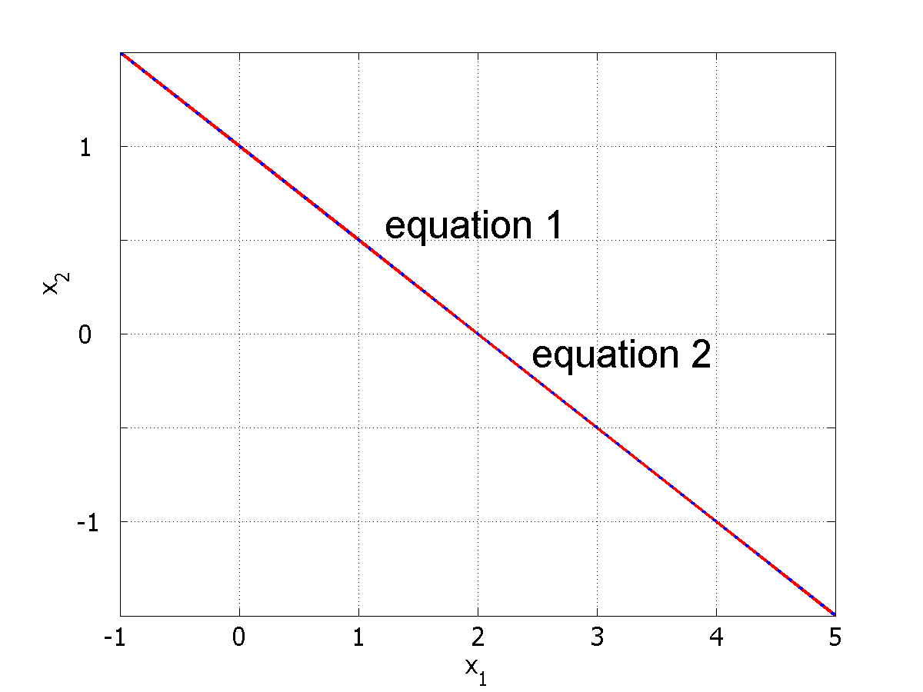
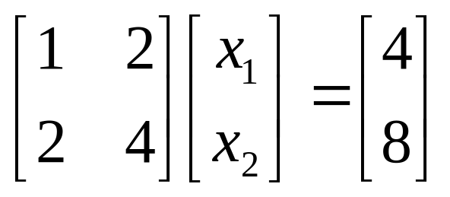
Rank deficient matrices
If Rank{A}=m<n
Det{A} = 0 ⇒ A is singular so not invertible
infinite number of solutions (n-m free variables)
under-determined system
Rank{A}=Rank{A|b}=1
Consistent so solvable

Slide 8
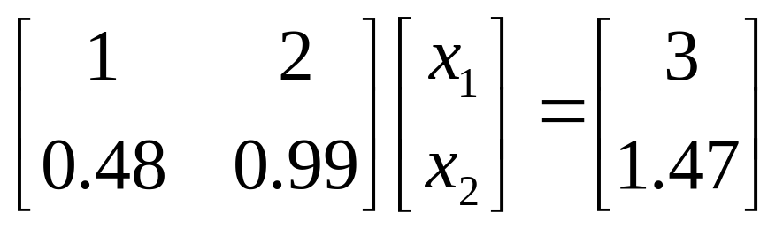
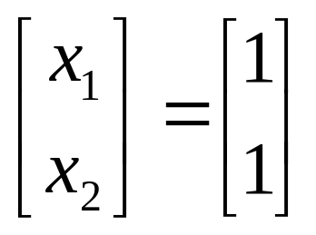
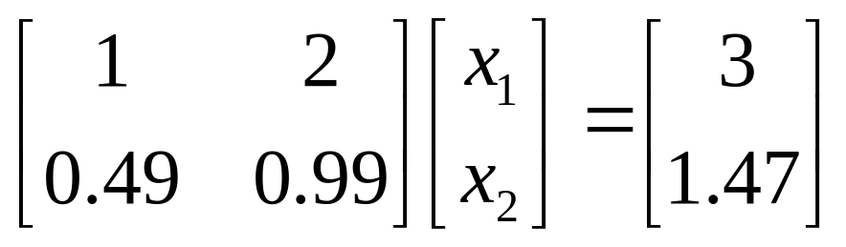
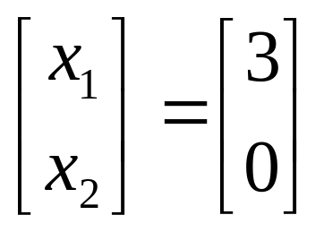
Ill-conditioned system of equations
A small deviation in the entries of A matrix, causes a large deviation in the solution.
⇒
⇒

Slide 9
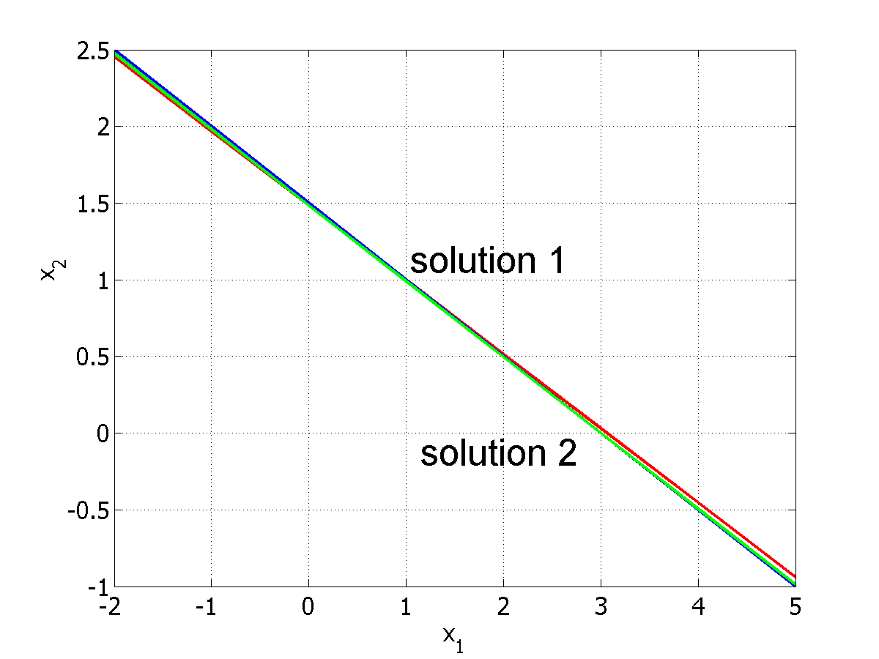
Ill-conditioned continued.....
A linear system of equations is said to be “ill-conditioned” if the coefficient matrix tends to be singular

Slide 10
Types of linear system of equations to be studied in this course
Coefficient matrix A is square and real
The RHS vector b is nonzero and real
Consistent system, solvable
Full-rank system, unique solution
Well-conditioned system

Slide 11
Solution Techniques
Direct solution methods
  Finds a solution in a finite number of operations by transforming the system into an equivalent system that is ‘easier’ to solve.
  Diagonal, upper or lower triangular systems are easier to solve
  Number of operations is a function of system size n.
Iterative solution methods
  Computes succesive approximations of the solution vector for a given A and b, starting from an initial point x₀.
  Total number of operations is uncertain, may not converge.

Slide 12
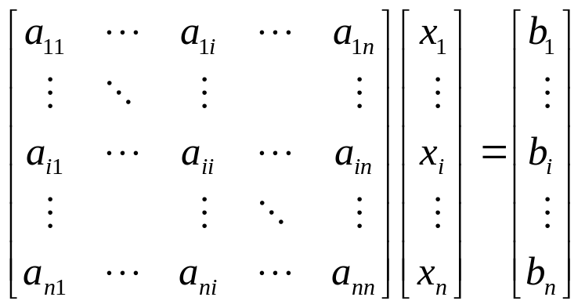
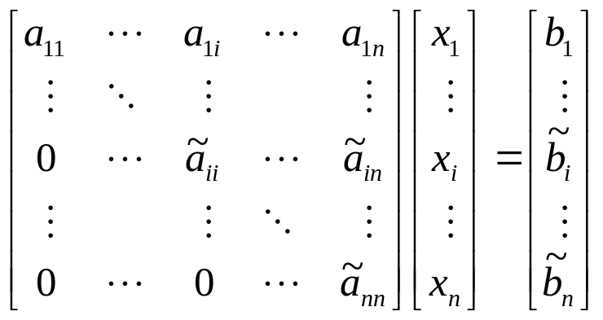
Direct solution Methods
Gaussian Elimination
  By using ERO, matrix A is transformed into an upper triangular matrix (all elements below diagonal 0)
  Back substitution is used to solve the upper-triangular system
⇒
Back substitution
ERO

Slide 13
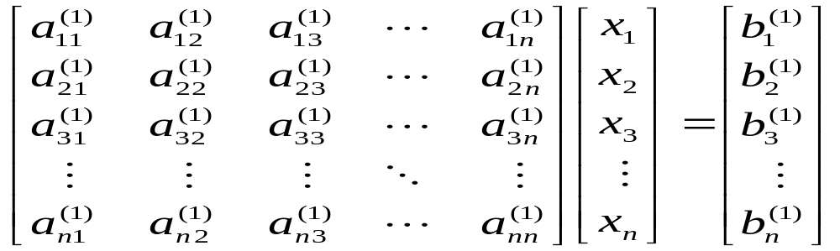
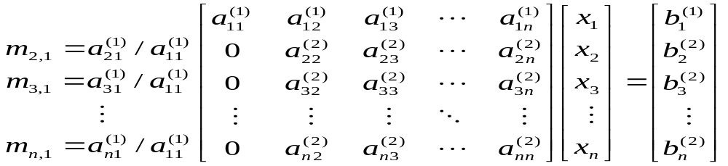
First step of elimination
Pivotal element

Slide 14
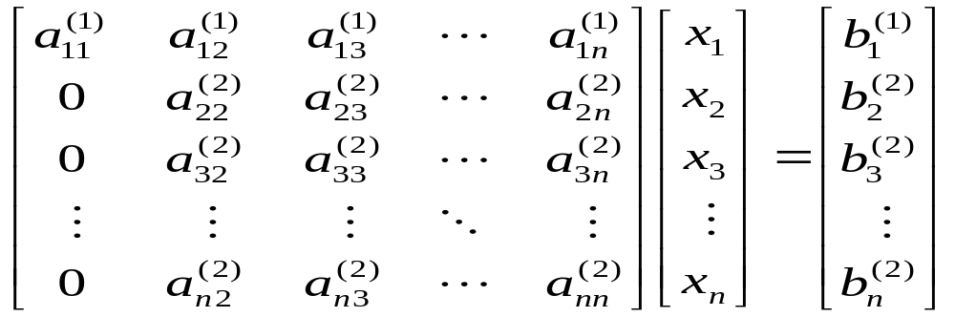
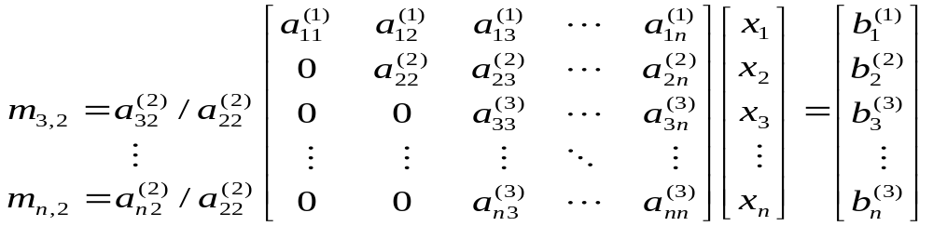
Second step of elimination
Pivotal element

Slide 15
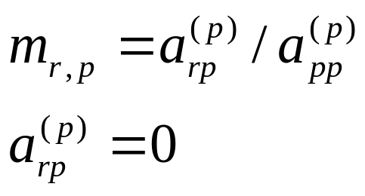
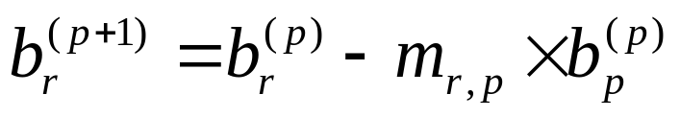
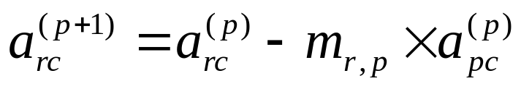
Gaussion elimination algorithm
Define number of steps as p (pivotal row)
For p=1,n-1
For r=p+1 to n
For c=p+1 to n

Slide 16
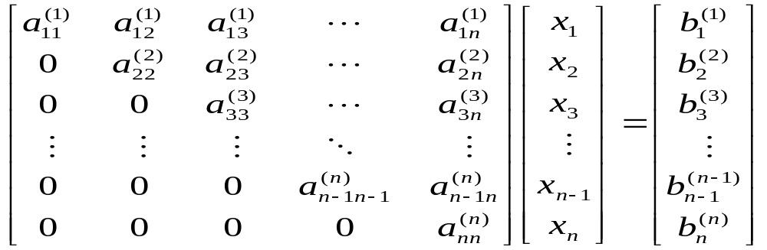
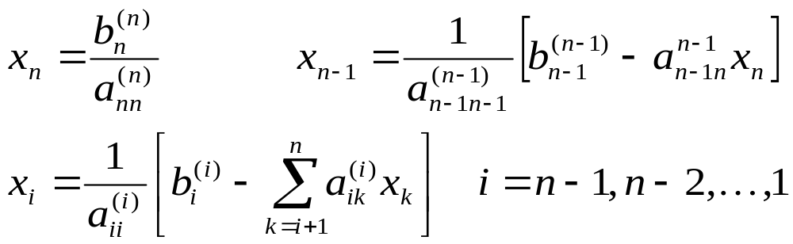
Back substitution algorithm

Slide 17
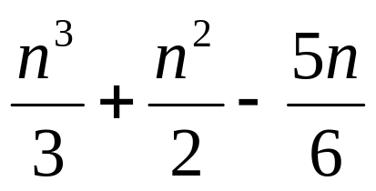
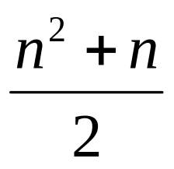
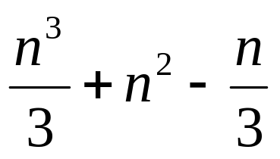
Operation count
Number of arithmetic operations required by the algorithm to complete its task.
Generally only multiplications and divisions are counted
Elimination process
Back substitution
Total
Dominates
Not efficient for
different RHS vectors

Slide 18
LU Decomposition
A=LU
Ax=b ⇒LUx=b
Define Ux=y
Ly=b Solve y by forward substitution
ERO’s must be performed on b as well as A
The information about the ERO’s are stored in L
Indeed y is obtained by applying ERO’s to b vector
Ux=y Solve x by backward substitution

Slide 19
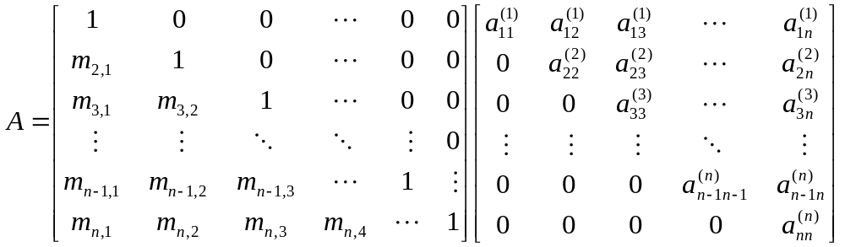
LU Decomposition by Gaussian elimination
There are infinitely many different ways to decompose A.
Most popular one: U=Gaussian eliminated matrix
L=Multipliers used for elimination
Compact storage: The diagonal entries of L matrix are all 1’s,
they don’t need to be stored. LU is stored in a single matrix.

Slide 20
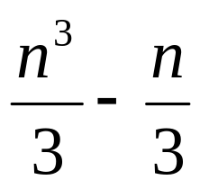
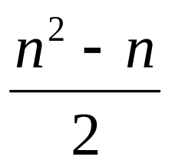
Operation count
Done only once
A=LU Decomposition
Ly=b forward substitution
Ux=y backward substitution
Total
For different RHS vectors, the system can be efficiently solved.

Slide 21
Pivoting
Computer uses finite-precision arithmetic
A small error is introduced in each arithmetic operation, error propagates
When the pivotal element is very small, the multipliers will be large.
Adding numbers of widely differening magnitude can lead to loss of significance.
To reduce error, row interchanges are made to maximise the magnitude of the pivotal element

Slide 22
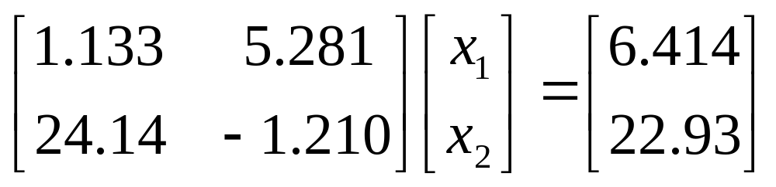
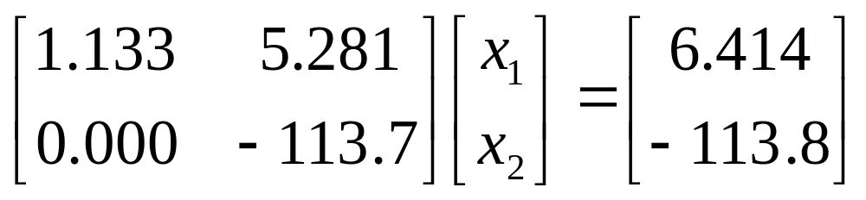
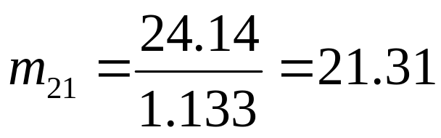
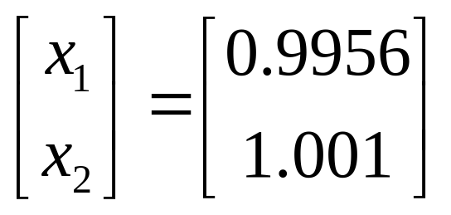
Example: Without Pivoting
4-digit arithmetic
Loss of significance

Slide 23
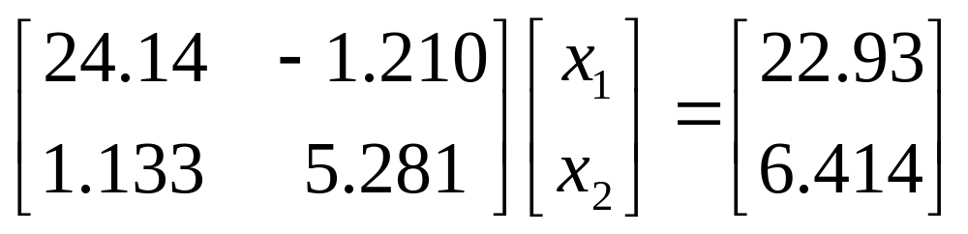
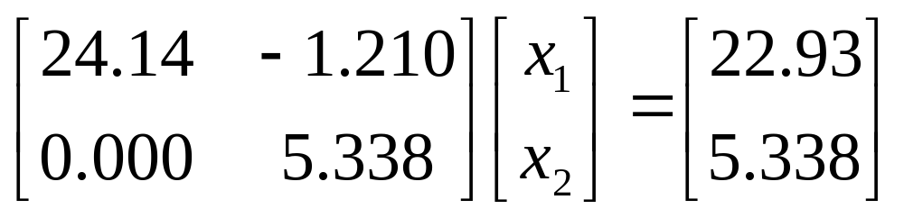
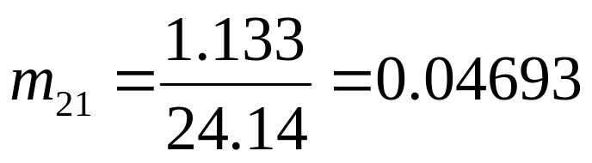
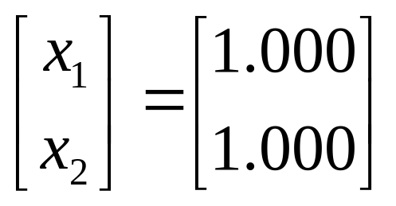
Example: With Pivoting

Slide 24
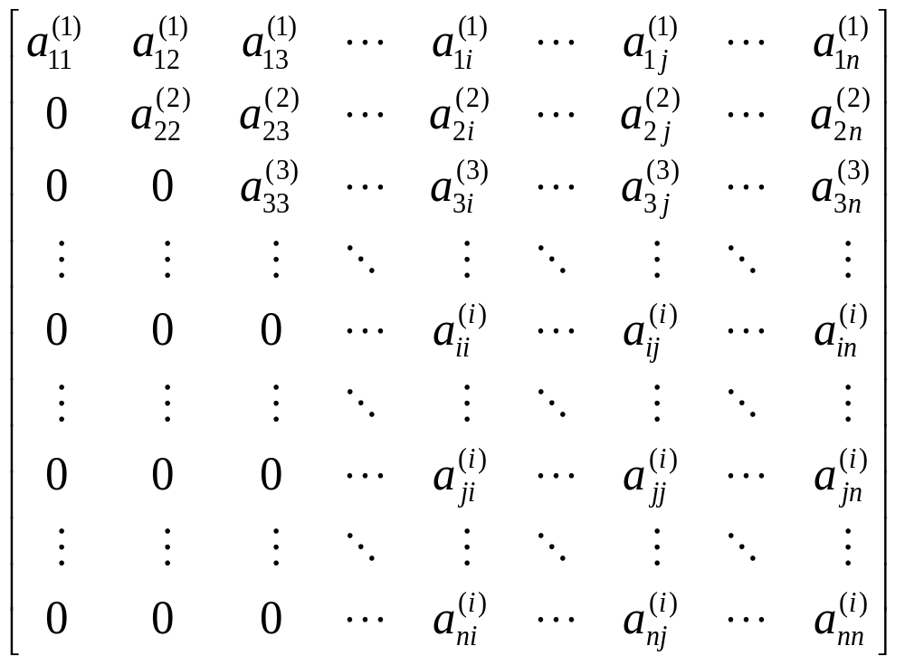
Pivoting procedures
Eliminated
part
Pivotal
row
Pivotal column

Slide 25
Row pivoting
Most commonly used partial pivoting procedure
Search the pivotal column
Find the largest element in magnitude
Then switch this row with the pivotal row

Slide 26
Row pivoting
Interchange
these rows
Largest in magnitude

Slide 27
Column pivoting
Largest in
magnitude
Interchange
these columns

Slide 28
Complete pivoting
Interchange
these rows
Largest in
magnitude
Interchange
these columns

Slide 29
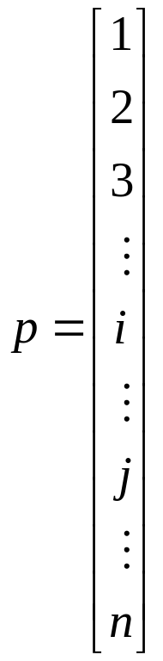
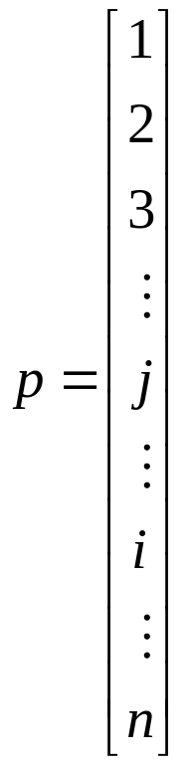
Row Pivoting in LU Decomposition
When two rows of A are interchanged, those rows of b should also be interchanged.
Use a pivot vector. Initial pivot vector is integers from 1 to n.
When two rows (i and j) of A are interchanged, apply that to pivot vector.

Slide 30
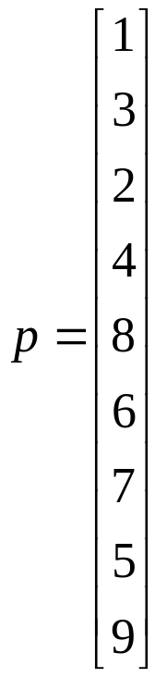
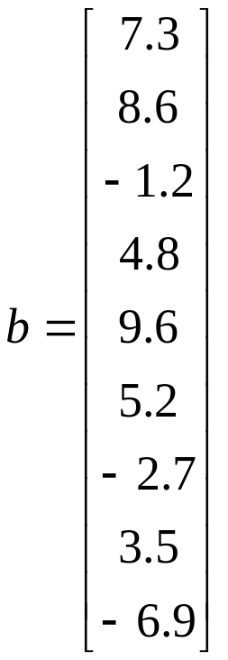
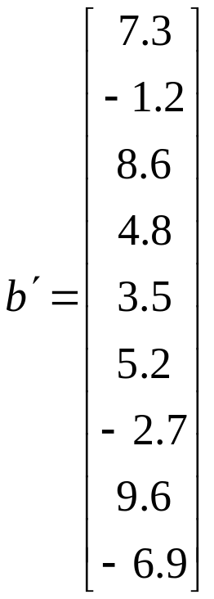
Modifying the b vector
When LU decomposition of A is done, the pivot vector tells the order of rows after interchanges
Before applying forward substitution to solve Ly=b, modify the order of b vector according to the entries of pivot vector

Slide 31
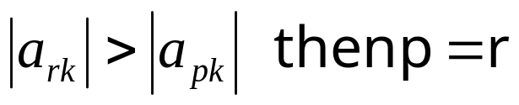
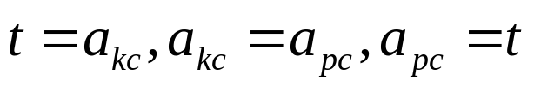
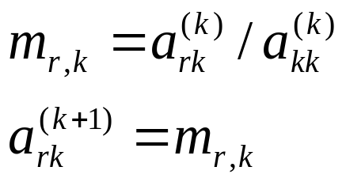
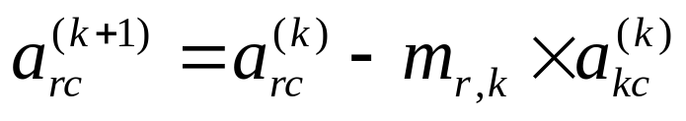
LU decomposition algorithm with row pivoting
For k=1,n-1 column to be eliminated
p=k
For r=k+1 to n
if
if p>k then
For c=1 to n
For r=k+1 to n
Column search for maximum entry
Interchaning the rows
Updating L matrix
For c=k+1 to n
Updating U matrix

Slide 32


Example
Column search: Maximum magnitude second row
Interchange 1st and 2nd rows

Slide 33

Example continued...
Eliminate a₂₁ and a₃₁ by using a₁₁ as pivotal element
A=LU in compact form (in a single matrix)
Multipliers (L matrix)

Slide 34

Example continued...
Column search: Maximum magnitude at the third row
Interchange 2nd and 3rd rows

Slide 35

Example continued...
Eliminate a₃₂ by using a₂₂ as pivotal element
Multipliers (L matrix)

Slide 36


Example continued...
A’x=b’ LUx=b’
Ux=y
Ly=b’

Slide 37




Example continued...
Ly=b’
Forward
substitution
Ux=y
Backward
substitution

Slide 38




Gauss-Jordan elimination
The elements above the diagonal are made zero at the same time that zeros are created below the diagonal

Slide 39


Gauss-Jordan Elimination
Almost 50% more arithmetic operations than Gaussian elimination
Gauss-Jordan (GJ) Elimination is prefered when the inverse of a matrix is required.
Apply GJ elimination to convert A into an identity matrix.

Slide 40



Different forms of LU factorization
Doolittle form
Obtained by
Gaussian elimination
Crout form
Cholesky form

Slide 41



Crout form
First column of L is computed
Then first row of U is computed
The columns of L and rows of U are computed alternately

Slide 42

Crout reduction sequence
2
4
6
1
3
5
7
An entry of A matrix is used only once to compute the
corresponding entry of L or U matrix
So columns of L and rows of U can be stored in A matrix

Slide 43
Cholesky form
A=LDU (Diagonals of L and U are 1)
If A is symmetric
L=U^{T} ⇒ A= U^{T} DU= U^{T} D^{1/2}D^{1/2}U
U’= D^{1/2}U ⇒ A= U’^{T} U’
This factorization is also called square root factorization. Only U’ need to be stored

Slide 44

Solution of Complex Linear System of Equations
Cz=w
C=A+jB Z=x+jy w=u+jv
(A+jB)(x+jy)=(u+jv)
(Ax-By)+j(Bx+Ay)=u+jv
Real linear system of equations

Slide 45


Large and Sparse Systems
When the linear system is large and sparse (a lot of zero entries), direct methods become inefficient due to fill-in terms.
Fill-in terms are those which turn out to be nonzero during elimination
Fill-in
terms
Elimination

Slide 46
Sparse Matrices
Node equation matrix is a sparse matrix.
Sparse matrices are stored very efficiently by storing only the nonzero entries
When the system is very large (n=10,000) the fill-in terms considerable increases storage requirements
In such cases iterative solution methods should be prefered instead of direct solution methods

